Slide 1

WSLab Datacenter Simulation: Scenarios
Jaromir Kaspar
Sr. Premier Field Enginner
Microsoft

Slide 2











Danke an unsere Partner!
Platinum Sponsor
Gold Sponsoren

Slide 3








Danke an unsere Partner!
Gold Sponsoren
Silber Sponsoren

Slide 4
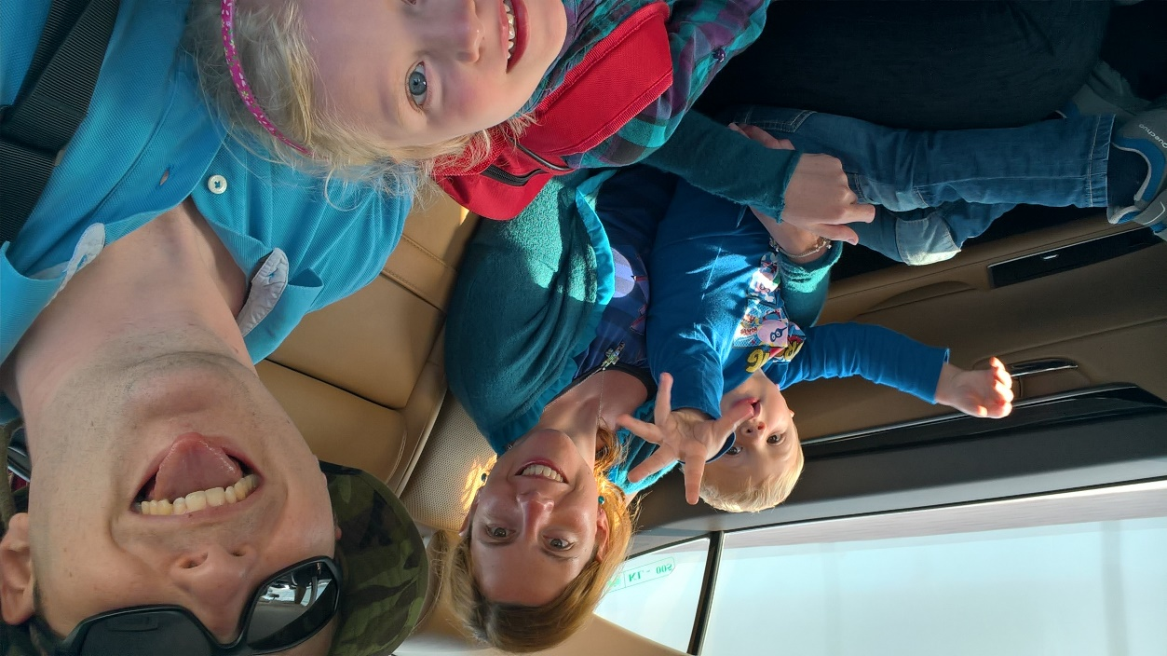
whoami /all /fo list
PFE@Microsoft for 7 years
Aka.ms/WSLab author
Azure Stack HCI: Storage Premier Workshop author

Slide 5

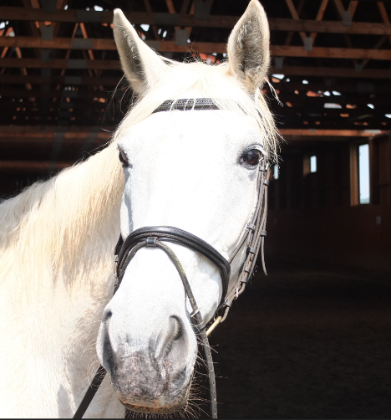



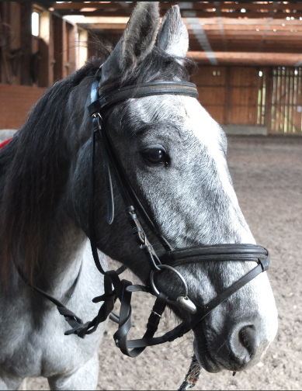


whoami /all /fo list
… and some other animals (kids included)
Sorted by age
And yes, I’m tired sometimes.

Slide 6
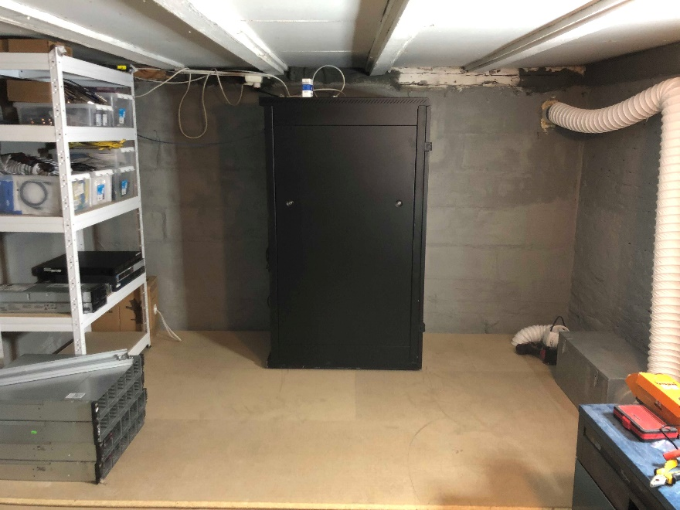
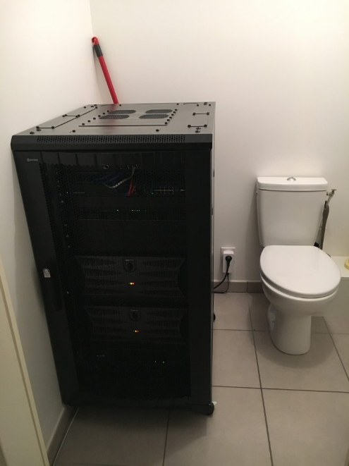
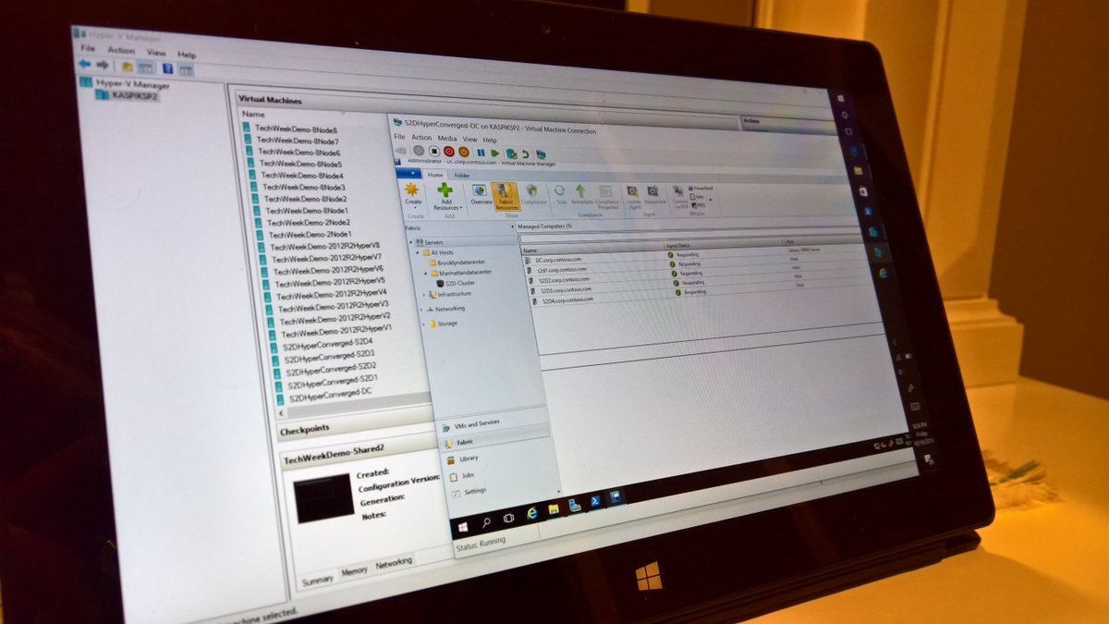
WSLab
Traditional labs
WSLab
vs
Jan-Tore Pedersen
heated basement
Romain Serre
heated bathroom
wslab
in Surface Pro 2

Slide 7
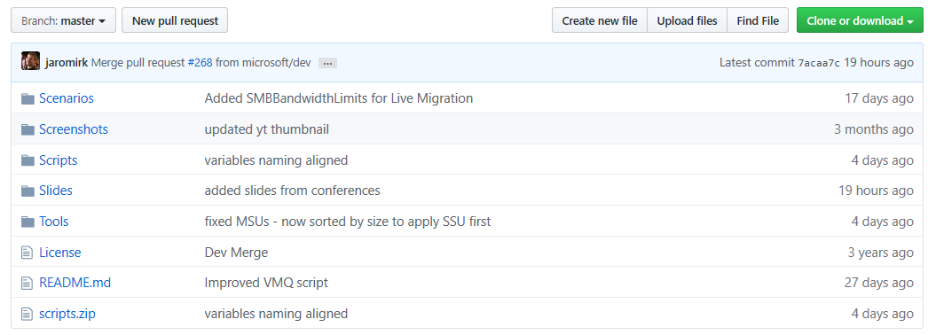
WSLab
All slides/scripts are already available under slides on GitHub!
http://aka.ms/wslab

Slide 8
About WSLab
All started in 2015 as scripts for SDS Workshop
Evolved in aka.ms/wslab
Tool to rapidly deploy labs (~5 minutes to deploy)
Configuration is in Hash table
Deploy 40 servers instead of 4 is one character change!
WSLab leads by example
More than 50 “scenarios” that demonstrate end-to-end server role configuration
All scenarios are built on Server Core, all uses PS remoting from management machine!

Slide 9
About Scenarios
All done from “Management” machine
Either DC or dedicated Win10 with RSAT
All scenarios respect best practices
All done with PowerShell
All uses –CimSession or Invoke-Command

Slide 10
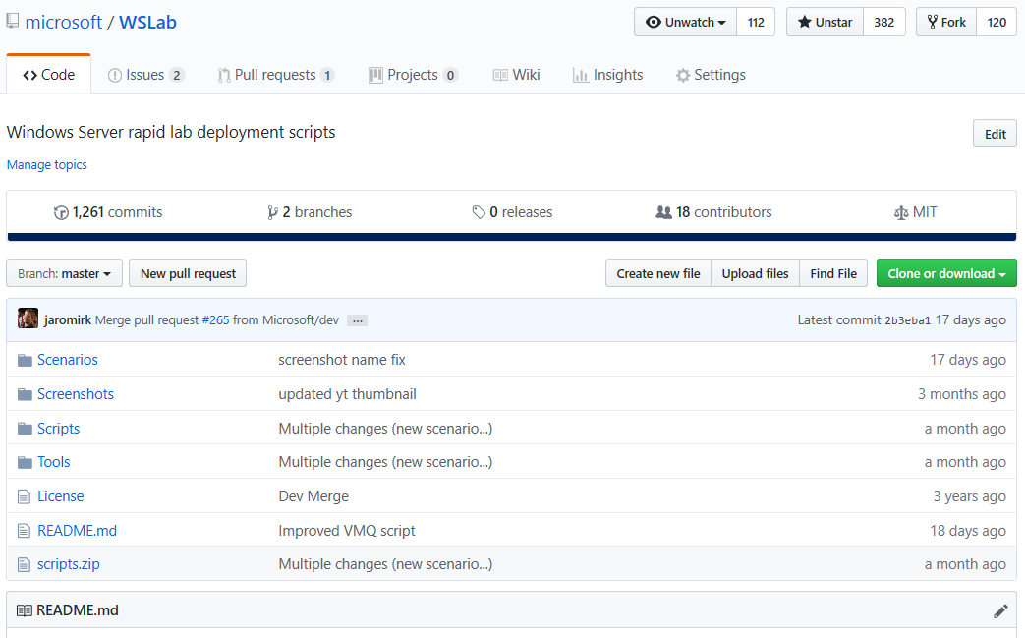
Scenarios

Slide 11
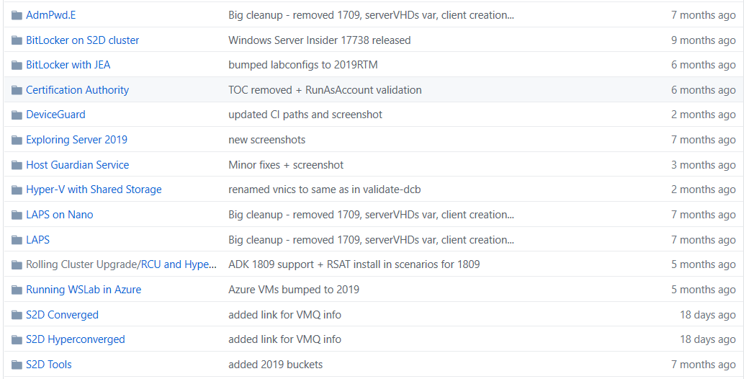
Scenarios

Slide 12
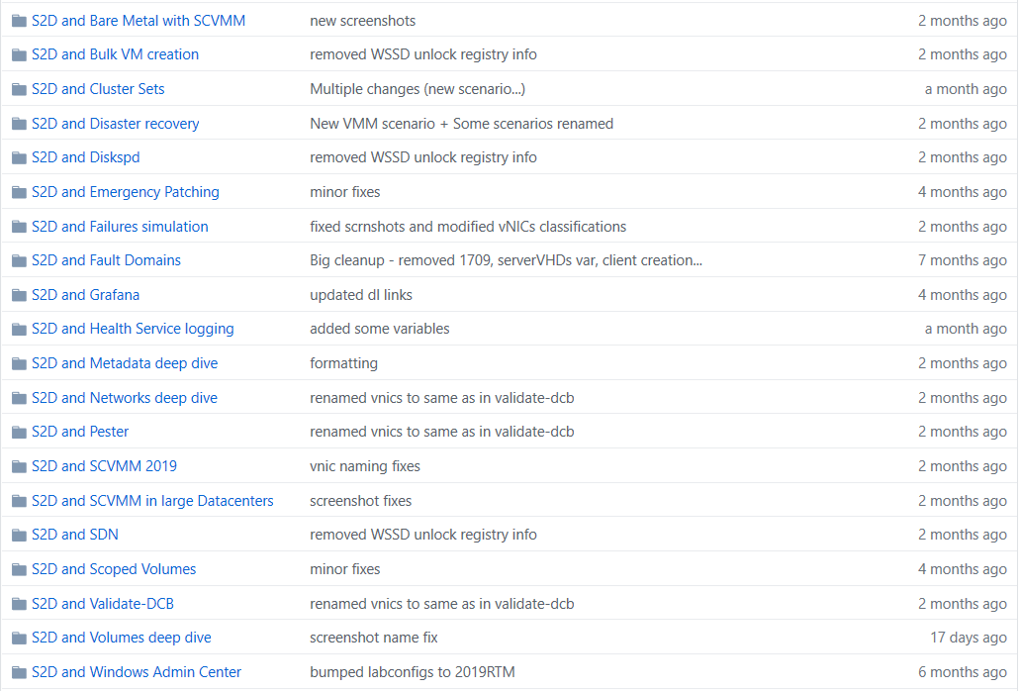
Scenarios

Slide 13
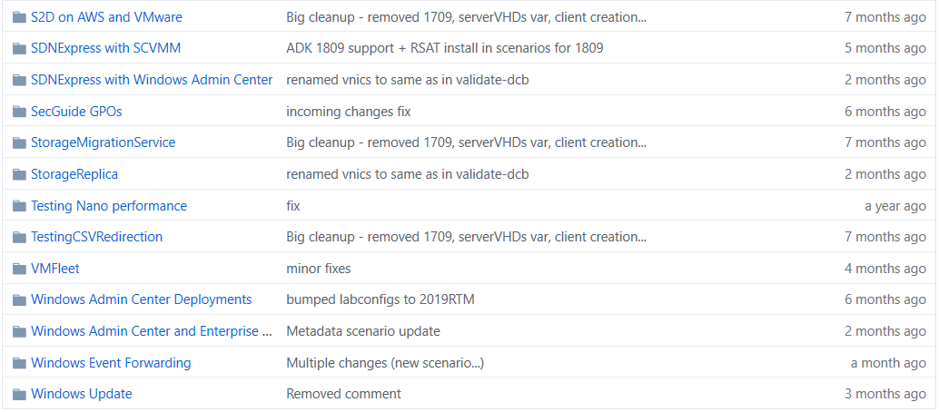
Scenarios

Slide 14
Complex Scenarios

Slide 15
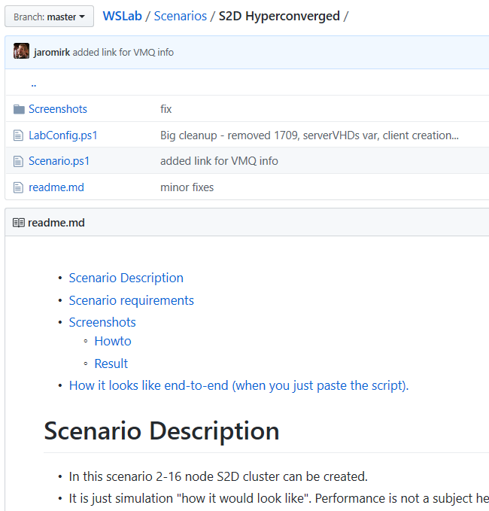
Complex Scenarios
Contains scenario.ps1
Also contains some description
Scenario.ps1 contains regions
You can run all, or study/run block by block
S2D Hyperconverged
S2D Converged
S2D and SCVMM Bare metal
Complex scenarios don’t have guide
It’s too long, too complex

Slide 16
S2D Hyperconverged
Simulates 2-16 nodes
Time to deploy ~30 minutes
Can run nested VMs
To play with LM
Contains ALL best practices
If not, ping me!

Slide 17
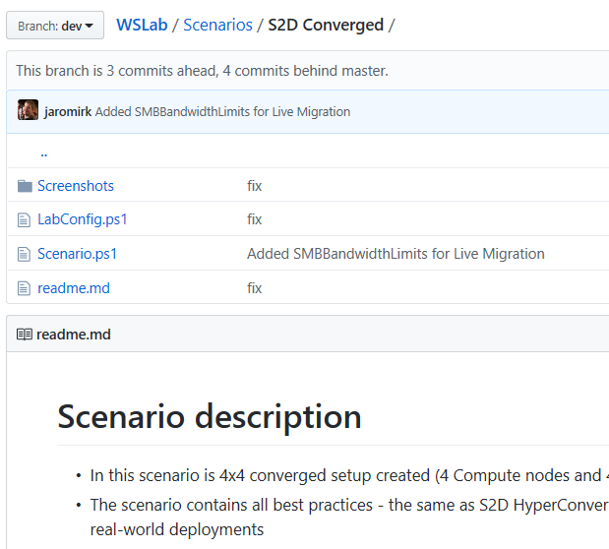
S2D Converged
Simulates 2-16 storage and 2-64 compute nodes
Demonstrates scaling up from 4x4 to 5x5
Following is the same as HCI
Time to deploy ~30 minutes
Can run nested VMs
To play with LM
Contains ALL best practices
If not, ping me!

Slide 18
Demo

Slide 19
Guided Scenarios

Slide 20
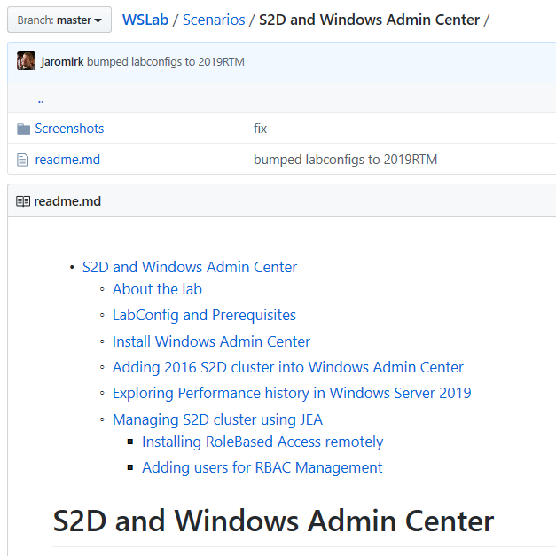
Guided Scenarios
All “S2D and …” and some others
I was not lazy and I wrote guide
Starts with Labconfig and Prereq
Contains screenshots, so you don’t need to spin WSLab, and just read

Slide 21
S2D and SCVMM
How to convert non-SCVMM installation to SCVMM
Creates Logical Networks
Converts standard switch to Logical Switch
…

Slide 22
S2D and SCVMM
How to convert non-SCVMM installation to SCVMM
Creates Logical Networks
Converts standard switch to Logical Switch
…

Slide 23
S2D and SCVMM in large Datacenters
Simulation of networking for 3 Datacenters
3 sites, 2 rooms each
Each room 2 aisles
Each aisle 4 racks
Each rack 2x10 nodes clusters
Considering 960 nodes in total!

Slide 24
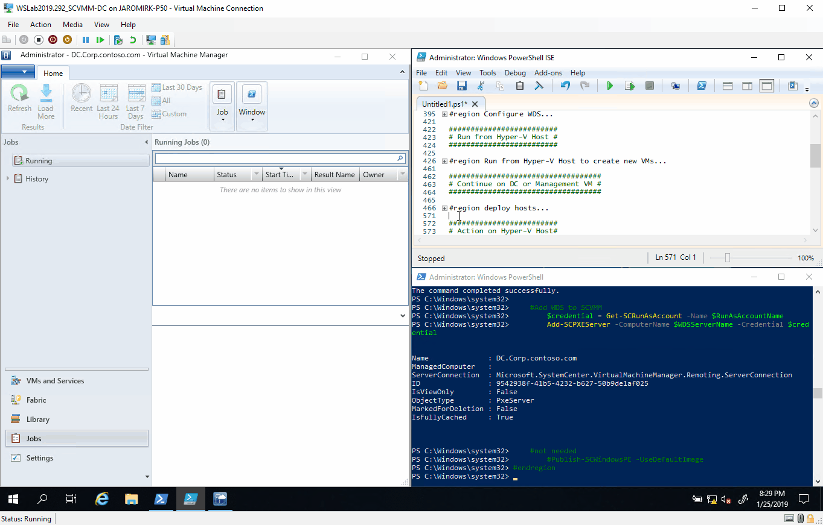
S2D and SCVMM bare metal deployment
S2D Deployed “easy” with SCVMM

Slide 25
Demo

Slide 26
“I was lazy” Scenarios

Slide 27
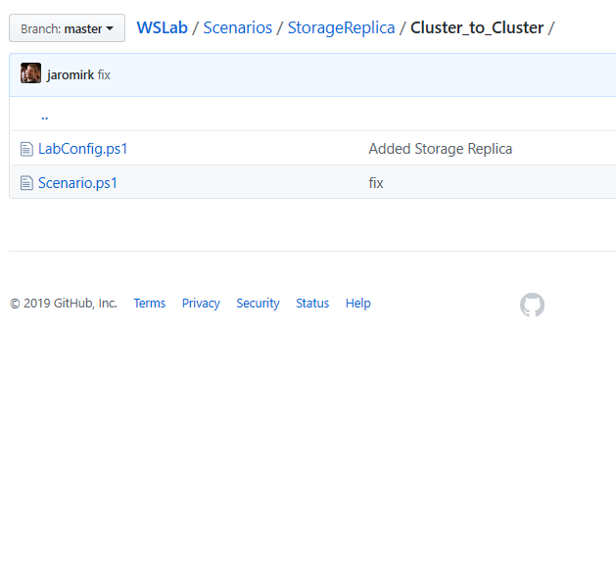
“I was lazy” Scenarios
Contains just Scenario.ps1 and Labconfig.ps1 only

Slide 28
Demo

